Slide 1
Regular Grammars
Describing Regular Languages

Slide 2
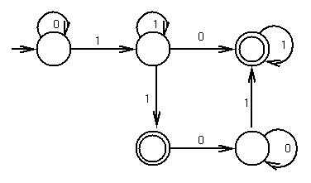
Regular Expressions
Can write regular language as an expression:
0*11*(0|100*1)1*|0*11*1
Operators:
Concatenation (adjacency)
Union (|, + or sometime written as ∨)
Kleene closure (* - 0 or more instances)

Slide 3
Regular Grammars
A regular grammar is a grammar where every production is of one of the two forms:
X → aY
X → a
for X, Y  Set of Variables, a  Terminals

Slide 4
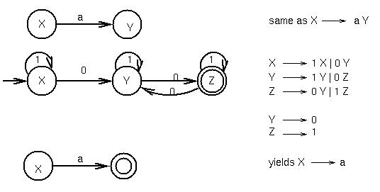
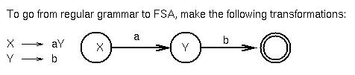
Equivalence Of FA And Regular Grammars

Slide 5
Why do we care about regular languages?
Programs are composed of tokens:
Identifier
Number
Keyword
Special symbols
Each of these can be defined by regular grammars

Slide 6
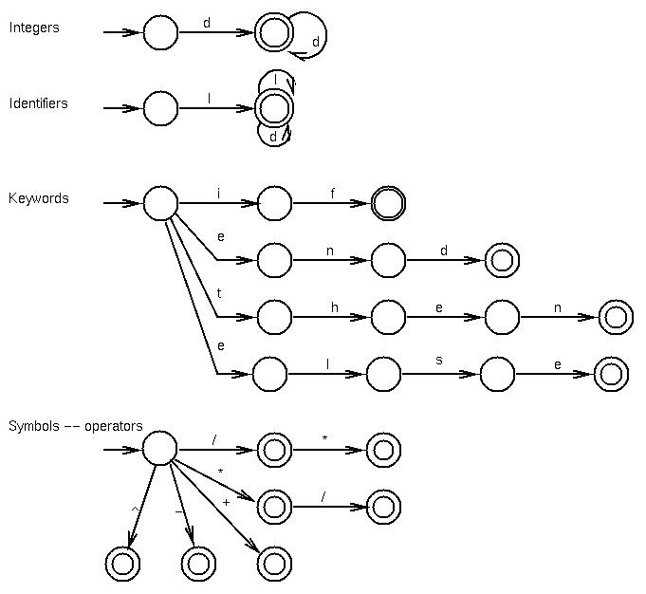
Sample token classes

Slide 7
Grammars

Slide 8
Grammars
Grammars express languages
Example: the English language

Slide 9
The Boy Walks

Slide 10
A Dog Runs

Slide 11
Language of the grammar
L = { “a boy runs”,
“a boy walks”,
“the boy runs”,
“the boy walks”,
“a dog runs”,
“a dog walks”,
“the dog runs”,
“the dog walks” }

Slide 12
Notation
Variable
or
Non-terminal
Terminal
Production
rule

Slide 13
Example
Grammar:
Derivation of sentence :

Slide 14
Example
Grammar:
Derivation of sentence :

Slide 15
Language of the grammar

Slide 16
Notation
Grammar
Set of variables
Set of terminal symbols
Start variable
Set of Production rules

Slide 17
Example
Grammar :

Slide 18
Notation
Sentential Form:
A sentence that contains variables and terminals
Example:
Sentential Forms
sentence

Slide 19
Language of a Grammar
For a grammar
with start variable :
String of terminals

Slide 20
A Convenient Notation

Slide 21
Linear Grammars

Slide 22
Linear Grammars
Grammars with at most one variable at the right side of a production
Examples:

Slide 23
A Non-Linear Grammar
Grammar :

Slide 24
Another Linear Grammar
Grammar :

Slide 25
Right-Linear Grammars
All productions have form:
Example:
or

Slide 26
Left-Linear Grammars
All productions have form:
Example:
or

Slide 27
Regular Grammars

Slide 28
Regular Grammars
A regular grammar is any
right-linear or left-linear grammar
Examples:

Slide 29
Observation
Regular grammars generate regular languages
Examples:

Slide 30
Regular Grammars Generate Regular Languages

Slide 31
Theorem
Languages
Generated by
Regular Grammars
Regular
Languages

Slide 32
Theorem - Part 1
Languages
Generated by
Regular Grammars
Regular
Languages
Any regular grammar generates a regular language

Slide 33
Theorem - Part 2
Languages
Generated by
Regular Grammars
Regular
Languages
Any regular language is generated by a regular grammar

Slide 34
Proof – Part 1
Languages
Generated by
Regular Grammars
Regular
Languages
The language generated by
any regular grammar is regular

Slide 35
The Case Of Right-linear Grammars
Let be a right-linear grammar
We will prove: is regular
Proof idea: We will construct NFA
with

Slide 36
The Case Of Right-linear Grammars
Grammar is right-linear

Slide 37
The Case Of Right-linear Grammars
Construct NFA such that every state is a grammar variable:
Special
Final state

Slide 38
The Case Of Right-linear Grammars
Add edges for each production:

Slide 39
The Case Of Right-linear Grammars

Slide 40
The Case Of Right-linear Grammars

Slide 41
The Case Of Right-linear Grammars

Slide 42
The Case Of Right-linear Grammars

Slide 43
The Case Of Right-linear Grammars

Slide 44
The Case Of Right-linear Grammars

Slide 45
In General
A right-linear grammar
has variables:
and productions:
or

Slide 46
The Case Of Right-linear Grammars
We construct the NFA such that:
each variable corresponds to a node:
special
final state

Slide 47
The Case Of Right-linear Grammars
For each production:
we add transitions and intermediate nodes
………

Slide 48
The Case Of Right-linear Grammars
For each production:
we add transitions and intermediate nodes
………

Slide 49
The Case Of Right-linear Grammars
Resulting NFA looks like this:

Slide 50
The Case Of Left-linear Grammars
Let be a left-linear grammar
We will prove: is regular
Proof idea:
We will construct a right-linear grammar with

Slide 51
The Case Of Left-linear Grammars
Since is left-linear grammar the productions look like:

Slide 52
The Case Of Left-linear Grammars
Construct right-linear grammar
In :
In :

Slide 53
The Case Of Left-linear Grammars
Construct right-linear grammar
In :
In :

Slide 54
The Case Of Left-linear Grammars
It is easy to see that:
Since is right-linear, we have:
Regular
Language
Regular
Language
Regular
Language

Slide 55
Proof - Part 2
Languages
Generated by
Regular Grammars
Regular
Languages
Any regular language is generated by some regular grammar

Slide 56
Proof - Part 2
Any regular language is generated by some regular grammar
Proof idea:
Let be the NFA with
Construct from a regular grammar such that

Slide 57
Proof - Part 2
Since is regular
there is an NFA such that

Slide 58
Proof - Part 2
Convert to a right-linear grammar

Slide 59
Proof - Part 2

Slide 60
Proof - Part 2

Slide 61
Proof - Part 2

Slide 62
In General
For any transition:
Add production:
variable
terminal
variable

Slide 63
In General
For any final state:
Add production:

Slide 64
In General
Since is right-linear grammar
is also a regular grammar
with

